Slide 1
Please complete the University Course Eval! https://tamu.aefis.net
Should take only 2-10 minutes, depending on whether you are willing to leave comments, too. I hope you will, and the more specific, the better.
My Promise: If you leave comments, I WILL READ them. Previous student comments have led me to change my course design in big and small ways.

Slide 2
Tough Issues & State Policy
Chapter 12C
Tough Issue #3: Education (Funding & Grad Rates)
Dr. Dwight Roblyer

Slide 3
Learning Objectives
Explain the challenges in analyzing data in the area of education or other social policies.
Define educational attainment as it is used in this lecture.
Characterize the correlations of economic, health, and crime measures with high school and college graduation rates in 2014.
Characterize the correlations of high school and college graduation rates with poverty rates from 1970-2014.
Discuss the similarities and differences between #4 and the correlations over the same period between infant mortality rate and high school and college graduation rates.
Explain why the correlations between contemporary public education spending and graduation rates are much weaker than those between lagged public spending and graduation rates.
Discuss the per-student public education spending in Texas, compare it to other states’ spending, and explain the significance of the difference. Also, briefly describe the connection between Texas education spending and its culture and politics.
Describe the inequity issue in Texas involving per-student funding in public schools, how policy has been adjusted in the past, and the outcome. Discuss how Texas falls behind in public education funding even in many of the years where it increases its education budget.

Slide 4
Learning Objectives
Describe the rationales and actions of the Texas state government regarding the public education budget in response to the Great Recession. Put that in context with respect to per-student funding in Texas from 2007-2016.
Discuss the differences between the FY16 revenue source weights in school funding in Texas and in the average US state. Also describe the difference between the per-student spending in Texas versus the average US state from 2007-2016.
Explain the issue at the heart of the 2013 suit by Texas school districts against the state, as well as the intermediate and final outcomes of that court action.
Describe the results of education funding reform efforts in the 2017 legislative session and how what funding resulted.
Discuss the impact of less funding for schools in poorer districts in Texas.
Explain the extent of inequities of per-student funding in Texas between districts and the role that the state and local governments play in any shortfalls that result in a given district.
Characterize the fairness ratios calculated for each of the US states and the picture they form. Compare Texas to its border-sharing neighbors.
Compare and contrast the amount of Ohio per-student revenue in each of the poverty-rate quintiles to those of Texas. What are the potential pros/cons of each?

Slide 5
Learning Objectives
Describe the outcome of education funding in the 2020-2021 biennial budget in Texas.
Characterize the Texas high school graduation rates from 2007-2016.
Discuss possible reasons that recent graduation rates may be inflated or inaccurate and why this is suspected.
Describe the problem posed by the number of high schools in Texas reporting a 100% graduation rate in 2017.
Explain what happened at Ballou High School in 2017, whether it is an isolated event, and what this means about measuring educational attainment.
Discuss the questions about excellence and equity that should be raised in Texas based on how it funds its public schools and how it measures educational attainment.

Slide 6
Focusing on two of many educational policy issues…
Assessing quality of K-12 public education systems is a frequent objective
Measure #1: How much and how fairly do states fund?
Measure #2: How many graduates & dropouts result?
We won’t address other issues also worthy of hard questions, careful use of data, and strong suspicions of biased conclusions
Standardized testing as a reliable & valid measure of learning and progress
Pros and cons of traditional and alternative schooling models (e.g., charter schools)
Other facets of school funding:
Performance-based funding: Schools with higher marks get more $$$$
Vouchers: Parents receive their student’s “share” of public ed funding, and are free to spend it at private schools

Slide 7
Aren’t Policy Decisions Data Driven?
Much data we would desire in this area, or in any of the other policy areas, are not available at state and local levels
Sometimes can be found, but not in quantity or quality necessary for solid statistical analysis
Data that we do have often show mixed results
Makes it even harder to argue that correlation supports causation
Allows either “side” to find support for their view point
Remember this as you view the following correlation charts based on data collected across all 50 states

Slide 8
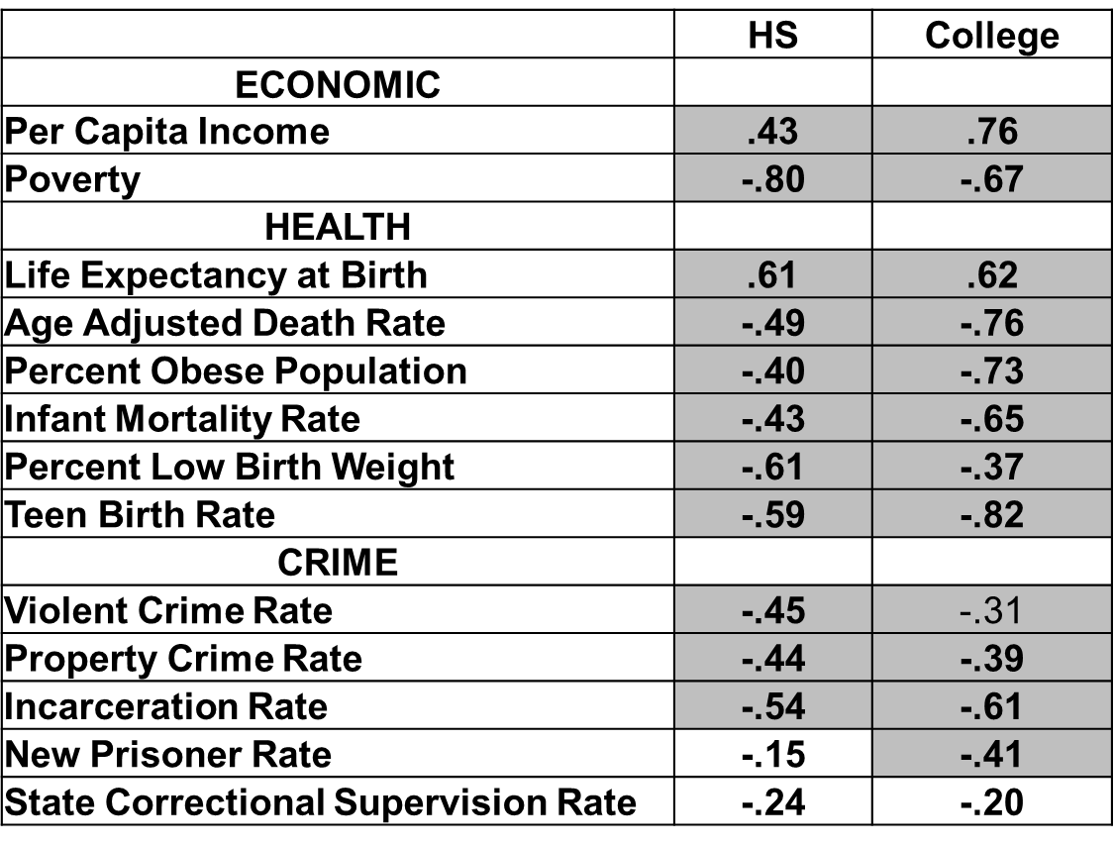
Correlations of Societal Benefits & Educational Attainment (2014)
What’s
this?
Only three correlations are below our threshold—many others indicate strong correlation
Sometimes HS is stronger, sometimes College

Slide 9
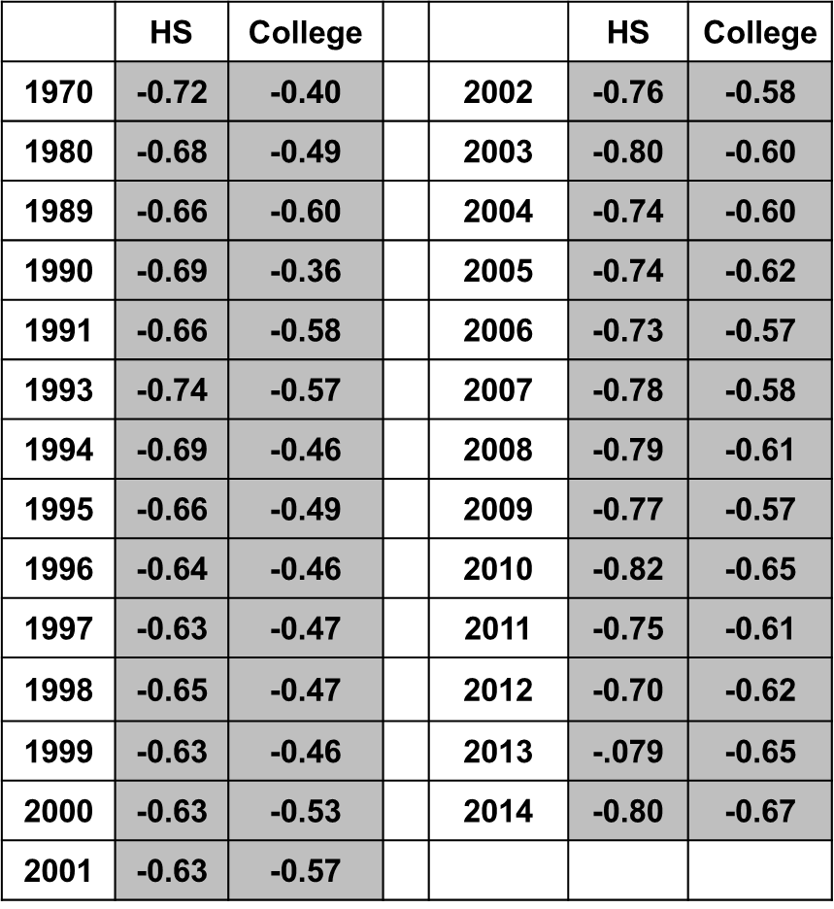
Educational Attainment and Poverty Rate Correlations
What type of empirical relationships?
How strong?
How do they vary across the years?
Which achievement has the largest effect? Why?

Slide 10
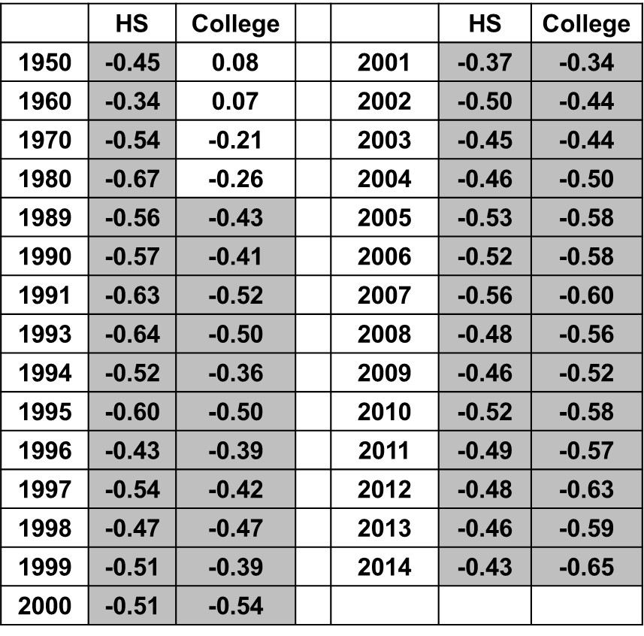
Educational Attainment and Infant Mortality Rate Correlations
What type of empirical relationships?
How strong?
How vary across the years?
Which achievement has the largest effect? Why?

Slide 11
Governments and Education Levels
As we said before, ALL states want to have “excellent” public education programs
High school completion is an explicit goal, and also a common measure
“Excellence,” though, is in the eye of the beholder
Increased funding is one way that states and local governments seek to improve their HS graduation rate
So… is there a positive relationship between educational resources ($$ spent) and results (HS graduates)?

Slide 12
Correlations Between Contemporary State Spending Per Child in Average Daily Attendance and Educational Attainment
 | HS | College |  |  | HS | College
1970 | 0.45 | 0.42 |  | 1999 | 0.23 | 0.42
1980 | 0.50 | 0.51 |  | 2000 | 0.21 | 0.46
1989 | 0.38 | 0.51 |  | 2001 | 0.20 | 0.48
1990 | 0.37 | 0.38 |  | 2002 | 0.25 | 0.48
1991 | 0.37 | 0.50 |  | 2003 | 0.24 | 0.46
1993 | 0.31 | 0.44 |  | 2004 | 0.25 | 0.44
1994 | 0.34 | 0.46 |  | 2005 | 0.25 | 0.47
1995 | 0.34 | 0.56 |  | 2006 | 0.25 | 0.54
1996 | 0.33 | 0.49 |  | 2007 | 0.32 | 0.52
1997 | 0.27 | 0.48 |  | 2008 | 0.30 | 0.53
1998 | 0.28 | 0.47 |  | 2009 | 0.38 | 0.52
1970 | 0.45 | 0.42 |  | 2010 | 0.35 | 0.51
Money spent in the same year as grad rates were measured
Not very predictive for High School completion!
Is this measure of spending the best one? Why or why not?

Slide 13
Correlations Between State Spending Per Child in Average Daily Attendance Twenty Years Earlier and Educational Attainment
 | HS | College |  |  | HS | College
1970 | 0.70 | 0.47 |  | 2000 | 0.38 | 0.46
1980 | 0.66 | 0.48 |  | 2001 | 0.39 | 0.43
1989 | 0.51 | 0.49 |  | 2002 | 0.45 | 0.41
1990 | 0.47 | 0.44 |  | 2003 | 0.38 | 0.41
1991 | 0.49 | 0.48 |  | 2004 | 0.38 | 0.42
1993 | 0.39 | 0.52 |  | 2005 | 0.42 | 0.42
1994 | 0.42 | 0.52 |  | 2006 | 0.40 | 0.51
1995 | 0.38 | 0.42 |  | 2007 | 0.43 | 0.58
1996 | 0.50 | 0.58 |  | 2008 | 0.40 | 0.61
1997 | 0.55 | 0.48 |  | 2009 | 0.38 | 0.59
1998 | 0.49 | 0.42 |  | 2010 | 0.37 | 0.59
1999 | 0.48 | 0.38
It is the money that is injected much earlier that impacts education completion at these upper levels.
But what does the strength of the correlations say about the clarity of that linkage?

Slide 14
Educated Enough in Texas?
In 2015, Texas spent $8,998 per student, 46th in U.S
National average: $11,674 per student
Annual difference is $59,000 less per 22-pupil elementary classroom in Texas
Opponents of spending increases assert difference is due to state’s lower cost of living
Political leadership has grappled with the problem for decades – How much is enough?
Many years of discussion, political wrangling, judicial coercion
Difficult to address in low-taxation, spend-less culture
Often leads lots of speeches but no-action or little-action policy choices
…Put that way, hard to believe the absence of that much money wouldn’t make a big difference!

Slide 15
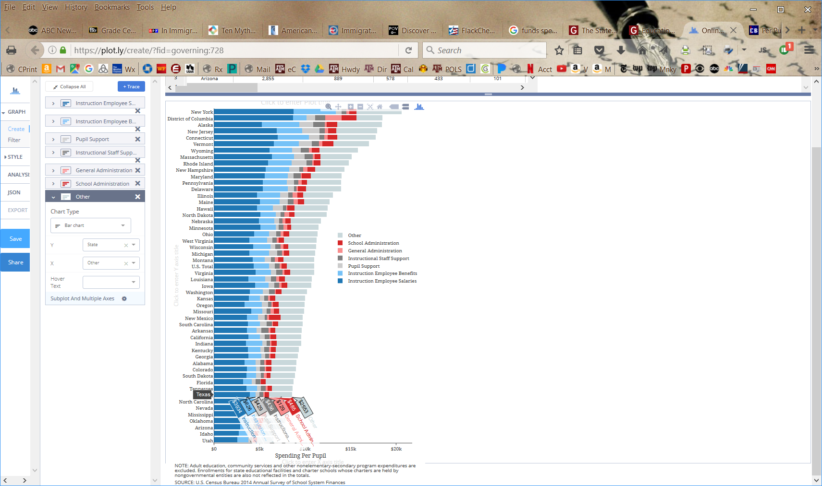
Per student 2014 Public Ed funding by state
Texas ranked 8th lowest that year in this analysis
http://www.governing.com/gov-data/education-data/state-education-spending-per-pupil-data.html

Slide 16
Some Recent History of Texas Education Funding
Equality of funding across poor and rich districts is long-standing major issue
Districts have sued the state 6 times since early 1980s
Key issue: “poor districts” do not receive sufficient state funds to deliver equal quality education as “well-off districts”
Tax base varies widely across Texas school districts, as do number of children requiring education—some are rich from property taxes and have relatively few children to educate
“Robin Hood” system in Texas calls on wealthier districts to transfer some of their funding to poorer districts—but system is resented, plagued with problems, and hasn’t resolved inequalities
Multiple “fixes” have been proposed, approved, defeated, and overturned
“Rich” districts fight hard against any attempt to redistribute any of their funding
http://texaspolitics.laits.utexas.edu/9_5_3.html

Slide 17
Some Recent History of Texas Education Funding
Increases to education funding over and beyond inflation are rare—increases to keep up with inflation and population don’t happen often, either!
Yet, student population grew 700K from 2004 to 2012 to total of 4.7 million pupils
State formulas for distributing state money are old enough to not reflect population changes in fast-growing cities
Great recession of 2008 hurt many states and almost all slashed public education spending
Texas Legislature took $5 billion in 2011 from biennial budget of $35 billion
In face of great public outcry, restored $3+ billion in 2013
…but it would have taken $5,178,226,096.85 to replace the original $5B!
…that’s 15% of education money that biennium!
http://texaspolitics.laits.utexas.edu/9_5_3.html

Slide 18
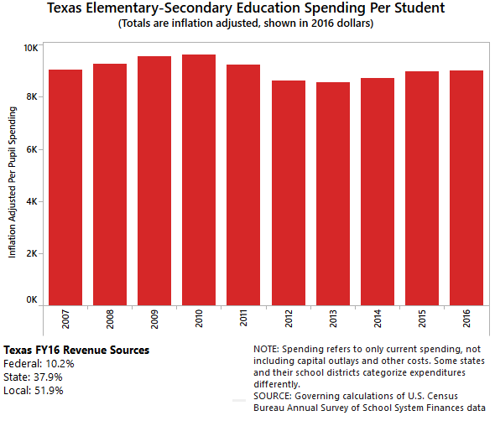
TX Per-Student Public Ed Funding
2007 Funding Level
Legislature cut $5B in the 2012-2013 biennium
…and then added back in $3B here
…but why doesn’t it look like $3B?)
http://www.governing.com/gov-data/education-data/state-education-spending-per-pupil-data.html

Slide 19
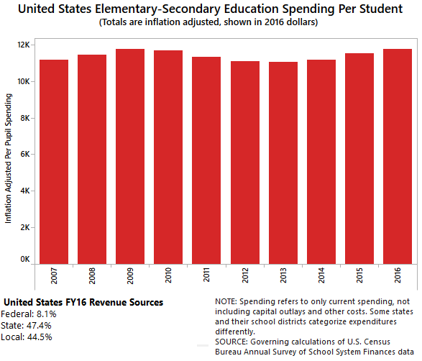
TX Per-Student Public Ed Funding
2007 Funding Level
U.S. Average
Legislature cut $5B in the 2012-2013 biennium
…and then added back in $3B here
…but why doesn’t it look like $3B?)
Texas
http://www.governing.com/gov-data/education-data/state-education-spending-per-pupil-data.html

Slide 20
Some Recent History of Texas Education Funding
State of Texas was sued (again) in 2013 by over 400 “low and medium wealth” school districts
Fort Bend ISD v. Texas Education Agency in Texas 200th Judicial District Court in Travis County
Aug 2014 District Court decision: State’s approach to funding its public schools is inequitable and therefore in violation of the state constitution
May 2016 Texas Supreme Court decision: “Our Byzantine school funding ‘system’ is undeniably imperfect, with immense room for improvement. But it satisfies minimum constitutional requirements” (Justice Willet, majority opinion)
Justice Guzman (concurring): "Good enough now ... does not mean that the system is good or that it will continue to be enough…. Shortfalls in both resources and performance persist in innumerable respects, and a perilously large number of students is in danger of falling further behind."
http://www.usnews.com/news/us/articles/2016-05-13/texas-high-court-upholds-school-funding-formula
http://texaspolitics.laits.utexas.edu/9_5_3.html
https://www.texastribune.org/2016/05/13/texas-supreme-court-issues-school-finance-ruling/

Slide 21
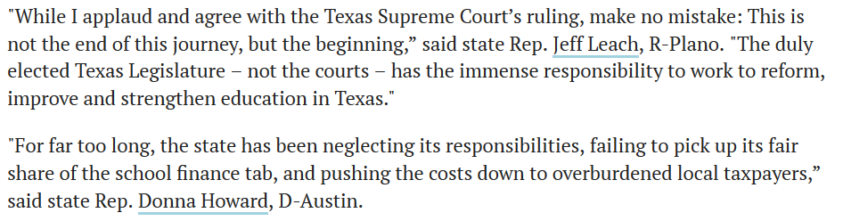
Legislature & Education Funding
Two camps formed, even before 2015 session began
“Don’t do anything—just let it play out in the courts”
“Do something right for Texas school children this session”
HB 1759 would have made multiple changes to how the State distributes its public education funds across districts
Would have increased funding per student, but possibly also increased inequities between districts
Some legislators will continue to fight to fix the problem they readily see—but will results ever change?
https://www.texastribune.org/2016/05/13/texas-supreme-court-issues-school-finance-ruling/

Slide 22
Legislature & Education Funding
2017 Session
Rep Aycock’s bill (reference HW 12C) to revamp public education funding did not pass
Different bill passed to increase public education funding
Increase didn’t cover inflation
Increase didn’t cover population increases
Outcomes:
More of funding burden shifted off to local school districts again
Funding inequities remain the same
https://www.texastribune.org/2016/05/13/texas-supreme-court-issues-school-finance-ruling/

Slide 23

Superintendent indicts state system for funding schools unfairly
https://youtu.be/l5h4rkrANmY

Slide 24
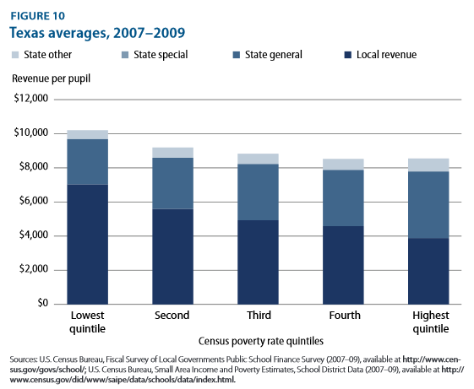
What Does Inequitable School Funding Look Like in Texas?
Poorest districts
Higher district necessity costs
Greater student needs
Less-healthy local economies
http://www.statewideonline.org/111312/files/StealthInequities%20Rutgers.pdf

Slide 25
What Does Unequitable School Funding Look Like in Texas?
STATE FUNDING
State is paying more of the bill
LOCAL TAX REVENUES
Poorest districts
Higher district necessity costs
Greater student needs
Less-healthy local economies
http://www.statewideonline.org/111312/files/StealthInequities%20Rutgers.pdf

Slide 26
What Does Unequitable School Funding Look Like in Texas?
But these gaps are the issue
STATE FUNDING
State is paying more of the bill
LOCAL TAX REVENUES
Poorest districts
Higher district necessity costs
Greater student needs
Less-healthy local economies
http://www.statewideonline.org/111312/files/StealthInequities%20Rutgers.pdf

Slide 27
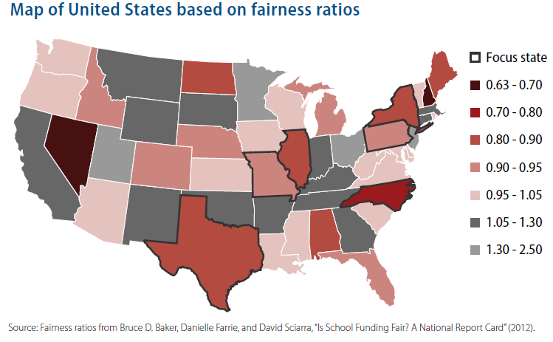
What Does Education Equity Look Like Across the U.S.?
(The funding in the highest
poverty schools divided by the funding in lowest poverty schools)
http://www.statewideonline.org/111312/files/StealthInequities%20Rutgers.pdf

Slide 28
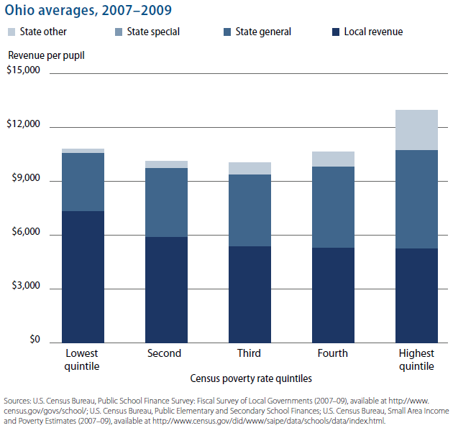
What Does Education Equity Look Like in Ohio?
http://www.statewideonline.org/111312/files/StealthInequities%20Rutgers.pdf

Slide 29
How did 2019 Legislature’s HB 3 Affect 2020-2021 School Funding?
Increased state contribution by about $10B
BUT also directed school districts to cut property tax rates, reducing local contributions
What will be overall affect?
We’ll find out in ~2022!
http://www.statewideonline.org/111312/files/StealthInequities%20Rutgers.pdf

Slide 30
What About System Output: How Does Texas Rank in High School Graduates?
Here are the rates from the Texas Education Commissioner & U.S. Dept of Education:
2007: 78%
2008: 79.1%
2009: 80.6%
2010: 84.3%
2011: 85.9% Tied for #3 in US
2012: 87.7% Tied for #4 in US
2013: 88% Tied for #2 in US
2014: 88.3% #5 in US
2015: 89% #4 in US
2016: 89.1% #5 in US
http://www.governing.com/gov-data/high-school-graduation-rates-by-state.html
http://tea.texas.gov/news_release.aspx?id=25769815030

Slide 31
Why Does Texas Rank So Highly?
Many celebrate these numbers, while others scratch their heads
When you divide the number of HS grads in 2013 by the number of 9th graders in 2009, the 2013 completion rate is closer to 72%
Instead, Texas uses a federally approved measure of HS completion
Complex system that tracks each 9th grader through graduation, or transferring dropping out
Numerous “codes” can be used to classify a student’s non-graduation as one that does not count against the HS completion rate
Permits “credit recovery” programs used by many TX districts—allow failing students to re-earn credits needed for graduation
Watch dogs & some school board members question accuracy of withdrawal coding and rigor of credit-recovery classes—point to lack of college readiness
Next time you visit your old high school ask them if they think the measure is solid!
http://www.mysanantonio.com/opinion/commentary/article/Stop-doubting-Texas-graduation-numbers-5879064.php
http://www.texastribune.org/2014/08/05/texas-posts-top-high-school-graduation-rates-again/
http://www.nytimes.com/2014/09/26/us/with-climbing-graduation-rates-come-renewed-doubts.html

Slide 32
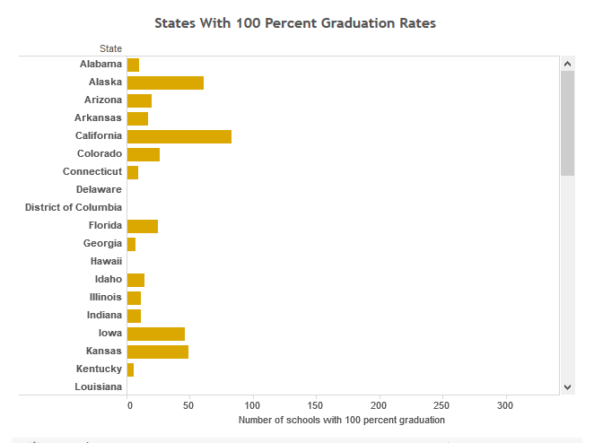
Why Does Texas Rank So Highly?
Many celebrate these numbers, while others scratch their heads
When you divide the number of HS grads in 2013 by the number of 9th graders in 2009, the 2013 completion rate is closer to 72%
Instead, Texas uses a federally approved measure of HS completion
Complex system that tracks each 9th grader through graduation, or transferring dropping out
Numerous “codes” can be used to classify a student’s non-graduation as one that does not count against the HS completion rate
Permits “credit recovery” programs used by many TX districts—allow failing students to re-earn credits needed for graduation
Watch dogs & School Board members question accuracy of withdrawal coding and rigor of credit-recovery classes—point to lack of college readiness
https://www.usnews.com/high-schools/best-high-schools/articles/2017-05-17/map-see-high-school-graduation-rates-by-state
US News & World Report’s data- access full table using link above.
Look at Texas
Look at other big-population states and compare
Something doesn’t seem right….
Next time you visit your old high school ask them if they think the measure is solid!
http://www.mysanantonio.com/opinion/commentary/article/Stop-doubting-Texas-graduation-numbers-5879064.php
http://www.texastribune.org/2014/08/05/texas-posts-top-high-school-graduation-rates-again/
http://www.nytimes.com/2014/09/26/us/with-climbing-graduation-rates-come-renewed-doubts.html

Slide 33


It’s a nationwide issue….
Washington D.C.
public school with
100% grad rate
in 2017
Text Removed
https://www.npr.org/sections/ed/2017/12/17/570255742/teachers-around-the-country-react-to-investigation-into-ballou-high-school

Slide 34
Lots of Questions Remain…!
What does “equitable” funding for “excellent” education look like?
What are the interests are both sides of the argument?
How is Texas likely to continue to respond to this question?
What is the best measure of educational attainment?
Is the current HS grad rate reason for Texas to cheer or jeer?
What could be alternative explanations for gaps between HS completion rates and college-readiness scores?
How does school funding translate into school completion in Texas? Will boosting the former also boost the latter?
Does this matter to you now? Will it matter to you in 15-20 years? When should it start mattering?
Gather expert opinions on both sides. Ask hard questions. Listen critically to the answers. Repeat!
http://www.mysanantonio.com/opinion/commentary/article/Stop-doubting-Texas-graduation-numbers-5879064.php
http://www.texastribune.org/2014/08/05/texas-posts-top-high-school-graduation-rates-again/
http://www.nytimes.com/2014/09/26/us/with-climbing-graduation-rates-come-renewed-doubts.html

Slide 35
Practice Problems …to begin mastering this material. Complete instructions are in the Module 1 resource, How to Use Practice Problems to Prepare for Exams.
Don’t forget to do the…

Slide 36
My Hope…

Slide 37
Savvy

Slide 38
Honorable

Slide 39
Compassionate

Slide 40
Principles Practicalities People

Slide 41
Working for your success

Slide 42
Please complete the University Course Eval! https://tamu.aefis.net
Should take only 2-10 minutes, depending on whether you are willing to leave comments, too. I hope you will, and the more specific, the better.
My Promise: If you leave comments, I WILL READ them. Previous student comments have led me to change my course design in big and small ways.

